Slide 1



Infection transmission
Instructions for use :
This training session is designed to be a pool of information allowing you to access the information you are interested in without having to go through the whole session or follow a particular order.
Please activate the slideshow mode to benefit from all its features.
X
Close
Previous Next
>
Close
Next

Slide 2
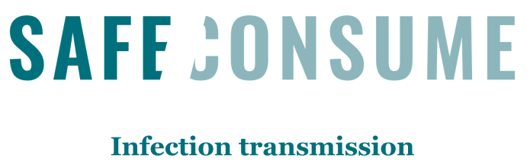
Learning objectives
To understand the chain of infection and critical points for food hygiene:
  To understand the concept of maintaining the cold chain and how to realize it
  To understand the concept of cross-contamination and how to avoid it
  To understand how to handle different kinds of meat as well as eggs safely
  To understand the correct way to check that food, including meat has been made safe to eat
  To understand and demonstrate the correct way to use a temperature probe
  To understand and reinforce that drying cloths and sponges makes a difference including transferring infections in the kitchen and how to prevent this
Curriculum links
Test your knowledge
Do the post-test
X
Pr Previous Next
>
Close
<
Next
Close

Slide 3
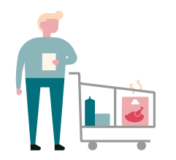
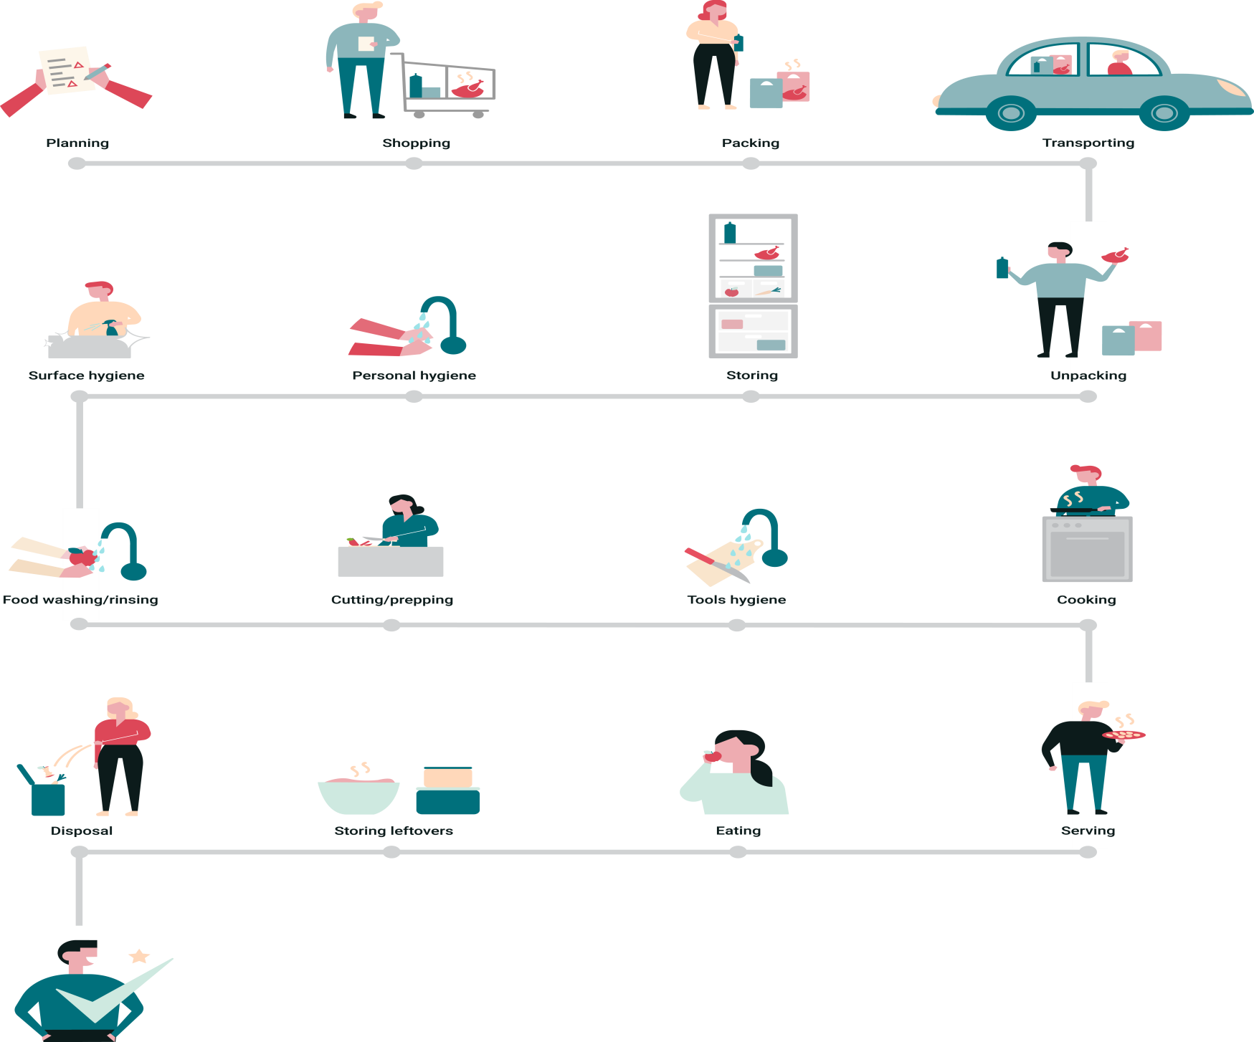
Planning
Shopping
Packing
Transporting
Curriculum links
Test your knowledge
Surface hygiene
Personal hygiene
Storing
Unpacking
Food washing/rinsing
Cutting/preppping
Tools hygiene
Cooking
Disposal
Storing leftovers
Eating
Serving
Do the post-test
X
Close
Close
Next

Slide 4

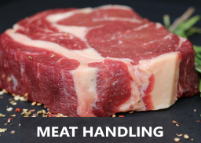
Planning and shopping
Plan your shopping (products from freezer at the end of your list)
Take cooler bags with you, a separate one for meat
Meat and vegetables are covered in microorganisms so whenever we buy, carry
  or store food we need to make sure they are separated to prevent cross contamination.
Read labels and in particular check use by dates
In trolley, store poultry/other meat and vegetables separately
Raw chicken/meat is often contaminated with food poisoning microbes and must be stored
separately from vegetables and other foods.
Use cooler bags to maintain cold chain
It will help slow the bacterial growth.
Curriculum links
Test your knowledge
More information on cross contamination
Download session 3 (food labels)
More information on the cold chain
Do the post-test
X
Back to main page
Close
Next

Slide 5
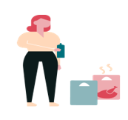


Packing and
Transporting
Use cooler bags and quick transport to maintain cold chain
To avoid cross contamination, transport poultry/other meat and vegetables separately
Unpack cooler bags first
  To limit bacterial proliferation it is important to store refrigerated products as quickly as possible (at room temperature, in the presence of water and nutrients, a bacterial cell can be divided into 2 daughter cells in only 20 minutes).
Take external temperature into account
Curriculum links
Test your knowledge
More information on the cold chain
More information on cross contamination
Do the post-test
X
Back to main page
Close
Next

Slide 6


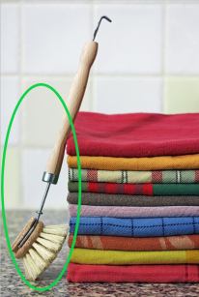
Surface and tools
hygiene
Wash surfaces with clean cloths (or sponges) then let them dry
  Wash all tools after contact with poultry/meat
  Brushes are cleaner than sponges
Curriculum links
Test your knowledge
Do the post-test
X
Back to main page
Close
Next

Slide 7


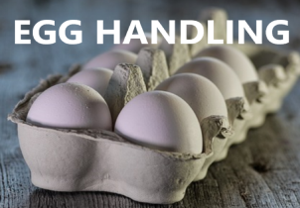
Storing/unpacking
Unpack cooler bags first
To limit bacterial proliferation it is important to store refrigerated products as quickly as possible (at room temperature, in the presence of water and nutrients, a bacterial cell can be divided into 2 daughter cells in only 20 minutes).
Fridge management :
  Identify food urgent to consume (first in - first out, keep track of use by dates)
  Identify how long has food been in the fridge (keep track of leftovers dates, maximum 3 days)
Store raw poultry/other meat separately from vegetables and ready to eat food
To avoid cross contamination store raw poultry/meat from other foods
Store eggs in fridge (not in the door)
Curriculum links
Test your knowledge
More information on the cold chain
More information on cross contamination
Do the post-test
X
Next
>
Back to main page
Next
Close

Slide 8


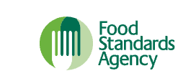
Storing/unpacking
Control temperature of fridge (≤4°C) and identify low and high temperature zones
Some harmful microbes can multiply at relatively cold temperature.
To avoid their multiplication it is important to keep the fridge temperature
less than or equal to 4°C.
Defrost in fridge
  As freezing does not kill bacteria, pathogenic bacteria (Salmonella enterica, Listeria monocytogenes) potentially present can multiply in the thawed food as soon as temperature gets high enough. This may happen if foods are thawed at room temperature.
  Frozen foods must be thawed in fridge and eaten or prepared rapidly.
If you are in a hurry, defrost can also be done in the microwave or in hot water.
Curriculum links
Test your knowledge
More information on the cold chain
More information :
Multi‐country outbreak of Listeria monocytogenes serogroup IVb, multi‐locus sequence type 6, infections linked to frozen corn and possibly to other frozen vegetables
How to store food and leftovers
How to chill, freeze and defrost food safely
Do the post-test
X
Previous
<
Back to main page
Next
Close

Slide 9


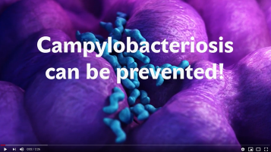
Cutting/prepping
  Use separate cutting boards and tools for poultry/meat and vegetables/bread
  Raw meat, including poultry, can contain harmful bacteria (Salmonella enterica, Campylobacter jejuni, Campylobacter coli ) that can spread to anything it touches (countertops, chopping boards, and knives).
  Direct and un-direct contacts between raw meat and ready-to-eat foods such as bread, salad and fruit must be avoided because these foods won't be cooked so any pathogen that get on to them won't be killed.
  More information:
  How to prepare and cook food safely
Curriculum links
Test your knowledge
More information on cross contamination
Campylobacteriosis can be prevented : video created by the Hungarian National Food Chain Safety Office for the World Food Safety Day.
Do the post-test
X
Back to main page
Close
Next

Slide 10

Personal hygiene
  Hand washing before and during food preparation (after raw poultry/meat handling, before preparing vegetables). Wash hands before eating.
    Raw food may contain pathogens that can be transferred to hands during food preparation.
    Other events can contaminate hands (touching the bin, door handles, touching pets, ….).
    Once contaminated, hands may disseminate pathogens to cooked foods, or directly to mouth during serving and eating.
  Use clean, dry towels or paper.
  More information:
  10 ways to prevent food poisoning
Curriculum links
Test your knowledge
More information on cross contamination
Do the post-test
X
Back to main page
Close
Next

Slide 11


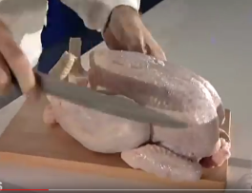
Food washing/rinsing
Curriculum links
Test your knowledge
  Clean vegetables carefully, especially if eaten raw
  Don’t wash poultry/meat, contamination risk is high
Video : See how the Campylobacter chicken bug spreads in a kitchen
This video was created by the Hungarian National Food Chain Safety Office for the first World Food Safety Day 2019
Do the post-test
X
Back to main page
Close
Next

Slide 12
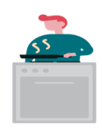



Cooking
  Cook poultry/meat thoroughly, check for doneness
      To kill pathogens that may contaminate raw meat and poultry a sufficient temperature must be reached and maintained long enough in all part of the meat during cooking.
      Pathogens may survive in “cold spots” which are particularly difficult to avoid in microwave, barbecue or in an open frying pan.
      No juice and no pink colour should remain in the middle of burgers, sausages, or between leg and breast for a whole bird.
      Ideally temperature should be checked with a thermometer.
  More informations:
  How to cook your food to prevent food poisoning
  Information on thermometers
Curriculum links
Test your knowledge
Do the post-test
X
Back to main page
Close
Next

Slide 13
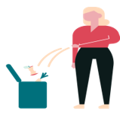

Disposal
Curriculum links
Test your knowledge
  Avoid using hands when disposing of food waste
  A pedal bin would be best to avoid bacteria transferring on hands
Do the post-test
X
Back to main page
Close
Next

Slide 14


Eating and serving
  Wash hands before eating
      Raw food may contain pathogens that can be transferred to hands during food preparation.
      Other events can contaminate hands (touching the bin, door handles, touching pets, ….).
      Once contaminated, hands may disseminate pathogens to cooked foods, or directly to mouth during serving and eating.
  Separate raw and cooked food
    Raw foods may contain pathogen. If they are transmitted to cooked foods, they will not be killed because the food is already cooked and will contaminate consumers.
    Reheating foods is usually not sufficient to kill pathogens.
    It is important to keep raw foods in separated and closed containers and to prevent any spilling of exudate, for
    instance from raw meat.
  More information:
  10 ways to prevent food poisoning
      Food safety in the home
Curriculum links
Test your knowledge
More information on cross contamination
Do the post-test
X
Back to main page
Close
Next

Slide 15

Storing leftovers
Heat only once
Leave maximum 2 hours in room temperature
Consume leftovers during max 3 days
Keep in fridge (≤ 4°C), label with date
What are the risks ?
Some species of pathogenic bacteria (Bacillus cereus, Clostridium perfringens, Clostridium botulinum…) produces very resistant bodies called “spores”.
These spores can be found in meat, milk, cereals, vegetables. Spores present in foods will not be killed by cooking and will multiply in the cooked foods whenever temperature is high enough.
Then they may infect us causing diarrhoea or produce deadly toxins in the foods.
That is why leftovers should be cooled rapidly, kept in the fridge and consumed within 3 days.
Curriculum links
Test your knowledge
Do the post-test
X
Back to main page
Close
Next

Slide 16


Why is it important to maintain the cold chain?
Why is it important to maintain the cold chain?
  Microbes grow rapidly, depending in particular on temperature.
  Fridge and freezer don’t kill microbes, microbial growth is only slowed down or stopped.
  If the cold chain is not maintained, bacteria may grow to high numbers and increase the risk of food-poisoning/infection.
How can we maintain the cold chain?
  Use cooler bags (or packing frozen with chilled foods) during transport from shop to home will help slowing bacterial growth.
  On arrival at home, store chilled and frozen products first.
  Don’t freeze twice: pathogenic bacteria may multiply in the thawed food and they won't be killed if the food is frozen again.
  Don’t put piping hot food in the fridge: it will raise your fridge temperature.
  Cool down leftovers as quickly as possible (within 2 hours) and store them in the fridge.
  Defrost frozen food in fridge: it will avoid microbial growth and will keep your fridge temperature down. If you are in a hurry, defrost can also be done in the microwave or in hot water.
Curriculum links
Test your knowledge
Do the post-test
How to store food and leftovers
X
Back to main page
Next
>
Close
Next

Slide 17
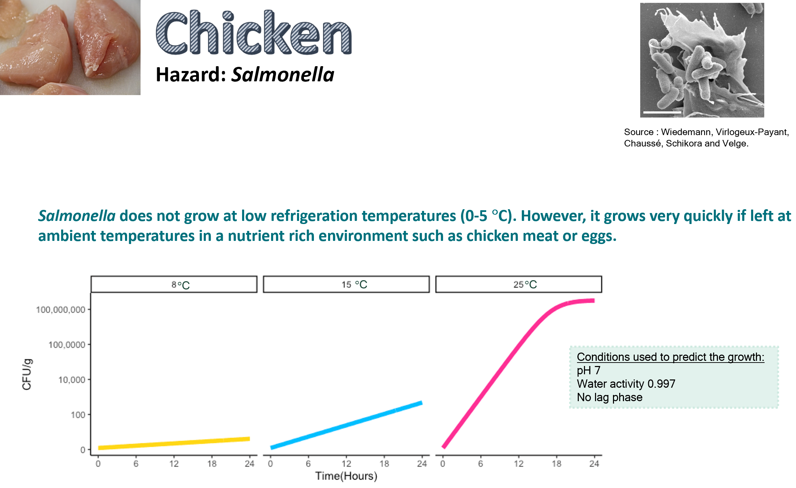
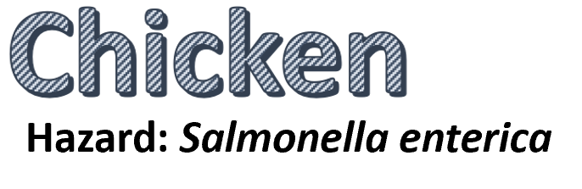
Curriculum links
Test your knowledge
Do the post-test
X
Back to main page
<
Previous Next
>
Close
Next

Slide 18
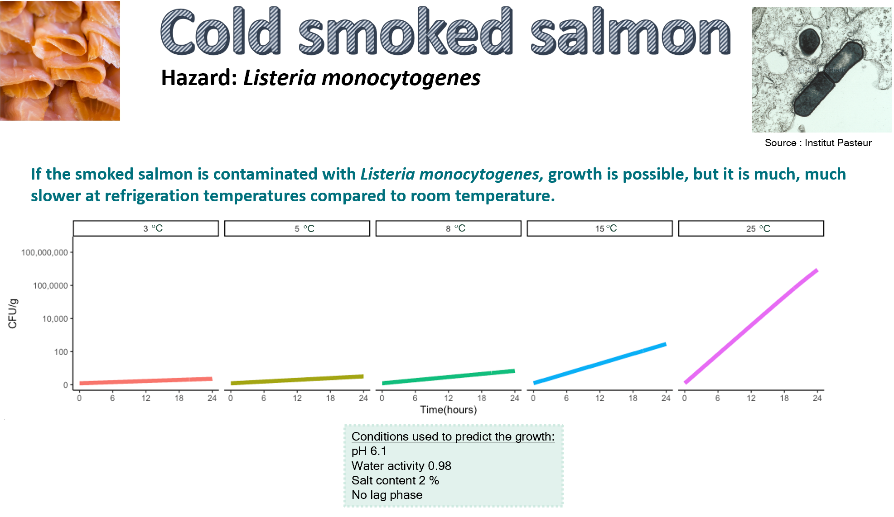
Curriculum links
Test your knowledge
Do the post-test
X
Back to main page
Previous
<
Close
Next

Slide 19
Avoiding
cross-contamination
Cross-contamination happens when harmful microbes from contaminated food (raw meat, soiled vegetables…) or objects (hands, tools, surfaces, towels, sponges, cloths, cutting boards…) are transferred to other food, especially « ready to eat » food. This can increase the risk of food poisoning.
You can avoid cross-contamination at several steps of the food journey by:
  Shopping safely:
  Separate raw and « ready to eat» food in your trolley.
  Using shopping bags safely:
  Separate raw and « ready to eat food» in different shopping bags.
  Label or colour code your (cooling) bags according to use and wash or replace them when necessary.
  Storing food safely:
      Separate raw and « ready to eat food ».
      Prevent spillages and contamination of the fridge by raw food (put raw meat in a box or in a covered plate).
      Protect « ready to eat » food from contamination (in a closed box or in a covered plate).
Curriculum links
Test your knowledge
Do the post-test
X
Back to main page
Next
>
Close
Next

Slide 20
Avoiding
cross-contamination
  Preparing food hygienically:
      Use different utensils, plates and chopping boards for raw meat, vegetables and « ready to eat food » or wash carefully
      between tasks.
      Don’t wash raw meat or meat packages.
      Don’t put cooked/grilled meat back onto the plate used for the raw meat.
      Wash your hands thoroughly with soap and water before cooking, handling « ready to eat food », and after touching raw meat.
      Use clean brushes, sponges, cloths or paper for cleaning and wiping. Let cloths and sponges dry out after use.
Curriculum links
Test your knowledge
Illustration of cross-contamination:
Campylobacteriosis can be prevented : video created by the Hungarian National Food Chain Safety Office for the World Food Safety Day.
Do the post-test
X
Back to main page
Previous
<
Close
Next

Slide 21
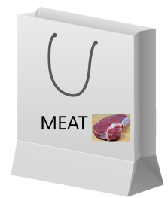
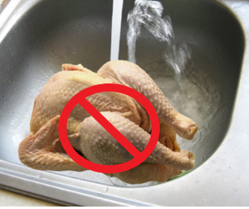
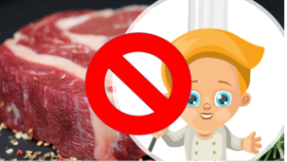
Meat handling
Store raw meat separately from vegetables during shopping, packing and transport.
Preparing fruits and vegetables eaten raw (e.g. for a salad) before raw meat limits the risk of transferring pathogens from the raw meat to the fruits and vegetables (i.e. cross contamination).
Do not wash raw meat in the sink. If needed to remove slime, it is preferable to use a
disposable paper towel (to avoid spreading pathogens that can be present on raw
meat in the kitchen).
Throw the package of the raw meat away immediately and do not wash it.
Raw meat can carry pathogens without any visible sign. While handling or preparing
raw meat do not put your hand to your mouth. Do not let young children handle
raw meat.
Curriculum links
Test your knowledge
Do the post-test
X
Back to main page
Next
>
Close
Next

Slide 22
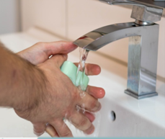
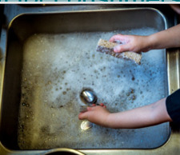
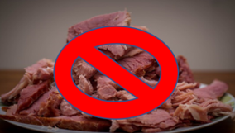
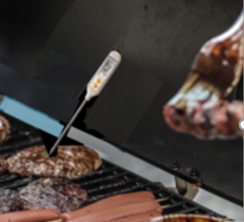
Meat handling
  Wash hands carefully with soap, rinse them and dry them with a clean cloth or with a paper towel, after handling raw meat and before touching/doing something else.
  Put aside (e.g. in the dish washer) or wash immediately with soap, surfaces and utensils in contact with raw meat, or soiled with raw meat juice (e.g. countertop, cutting board, knife, …).
  If preparing the fruits and vegetable eaten raw (e.g. for a salad) after raw meat (e.g. while the meat dish is cooking), do not use utensils, or surfaces, previously used for raw meat (e.g. do not use the same knife or the same cutting board) unless they have been washed thoroughly.
  Cook raw meat thoroughly and check doneness at the end of cooking. Visually, cut a piece in the thicker part of the meat, and check it is no longer glossy, that it is white with no pink colour left. If available, use a meat thermometer, the core temperature should be at least 75°C for raw poultry, pork meat and hamburger. For red meat cook until no pink is visible in the middle of the thickest part of the meat or until 65°C is reached. This is particularly important for consumers at risk (young children, pregnant women, elderlies, sick persons).
Curriculum links
Test your knowledge
Do the post-test
X
Back to main page
<
Next
Close
Previous

Slide 23
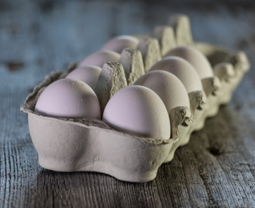
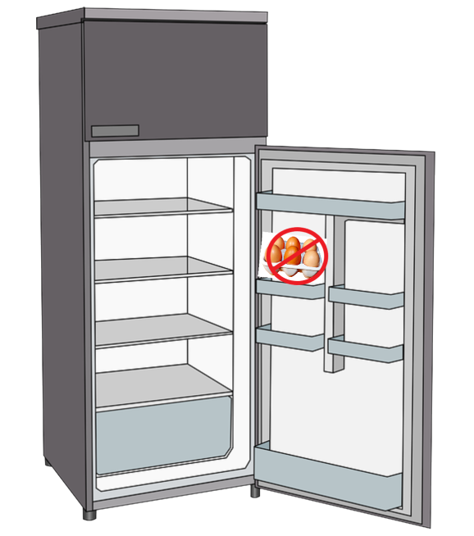
Egg handling
Check the date indicated on the packaging and do not buy eggs past this date.
Do not buy dirty eggs or eggs in dirty packages.
Keep eggs refrigerated after purchase but not in the fridge door which is usually the warmest place of the fridge.
Eggs and egg products are the most important food sources of confirmed cases of Salmonella enterica. Eggs can be contaminated with Salmonella enterica without any visible sign.
Curriculum links
Test your knowledge
Download session 2 (microbiological aspects)
Do the post-test
X
Back to main page
Next
>
Close
Next

Slide 24
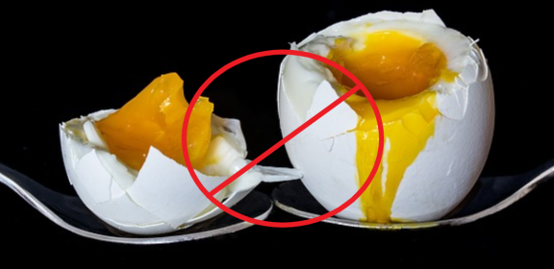

Egg handling
  Lightly cooking of eggs (runny yolk) does not kill Salmonella enterica.
  Preferably use pasteurized eggs (if available) to prepare dishes with raw eggs (mousse, mayonnaise, …) or with lightly cooked eggs (runny scramble eggs, fried eggs with liquid yolk, runny omelette, ….).
  If using fresh eggs, yolks can be heated for 15 min at 60 ºC and agitation with a cooking robot to kill Salmonella enterica while keeping them liquid. Other procedures can be found at: How to pasteurize eggs
  Backyard hens are not controlled for Salmonella enterica, as are hens from commercial farms, and their eggs are more at risk of being contaminated with Salmonella enterica.
Curriculum links
Test your knowledge
Do the post-test
X
Back to main page
Previous
<
Close
Next

Slide 25
Mobile phone
Mobile phones have been reported to be a reservoir for microorganisms (1,2,3,4,5,6) and can spread infectious diseases by their frequent contact with hands.
Ilusanya et al. (7) confirmed that, through hands to food transfer, a contaminated cell phone can infect the food and induce infection.
How to avoid it?
  when cooking, remember to wash your hands each time you touch a mobile phone (a tablet, etc.).
  disinfect your phone frequently (following the manufacturers' recommendations).
Curriculum links
Test your knowledge
References:
1) The microbial colonisation of mobile phone used by healthcare staffs.Kilic IH, Ozaslan M, Karagoz ID, Zer Y, Davutoglu V. Pak J Biol Sci. 2009 Jun 1; 12(11):882-4.
2) Is your phone bugged? The incidence of bacteria known to cause nosocomial infection on healthcare workers' mobile phones.Brady RR, Wasson A, Stirling I, McAllister C, Damani NN. J Hosp Infect. 2006 Jan; 62(1):123-5.
3) Degree of Bacterial Contamination of Mobile Phone and Computer Keyboard Surfaces and Efficacy of Disinfection with Chlorhexidine Digluconate and Triclosan to Its Reduction. Jana Koscova, Zuzana Hurnikova and Juraj Pistl. Int. J. Environ. Res. Public Health 2018, 15(10), 2238.
4) Are we aware how contaminated our mobile phones with nosocomial pathogens? Ulger F, Esen S, Dilek A, Yanik K, Gunaydin M, Leblebicioglu H.Ann Clin Microbiol Antimicrob. 2009 Mar 6;8:7. doi: 10.1186/1476-0711-8-7.
5) The potential role of mobile phones in the spread of bacterial infections. Akinyemi KO, Atapu AD, Adetona OO, Coker AO. J Infect Dev Ctries 3:628-632.
6) The Importance of Mobile Phones in the Possible Transmission of Bacterial Infections in the Community. Bhoonderowa, A., Gookool, S. & Biranjia-Hurdoyal, S.D. J Community Health (2014) 39: 965.
7) Personal hygiene and microbial contamination of mobile phones of food vendors in Ago-Iwoye Town, Ogun State, Nigeria. Ilusanya O.A.F., Adesanya O.O.L., Adesomowo A., Amushan N.A.. Pak. J. Nutr. 2012;11:276–278.
Do the post-test
X
Back to main page
Close
Next

Slide 26

Curriculum Links
KS2/KS3
RSHE; Health and prevention, Healthy eating
Science; Living things and their habitats
KS4:
Food preparation and nutrition GCSE; Cooking and food preparation - the scientific principles underlying the preparation and cooking of food.
Close and go back to session 4
X
Close
Next

