Slide 1



Teaching food hygiene: An introduction
Instructions for use :
This training session is designed to be a pool of information allowing you to access the information you are interested in without having to go through the whole session or follow a particular order.
Please activate the slideshow mode to benefit from all its features.
X
Close
Previous Next
>
Close
Next

Slide 2
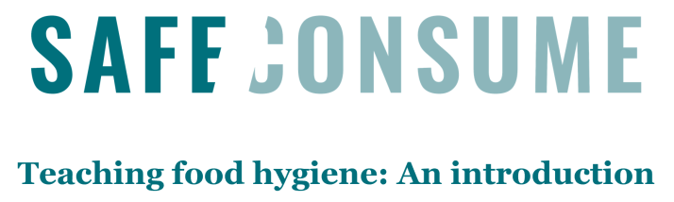
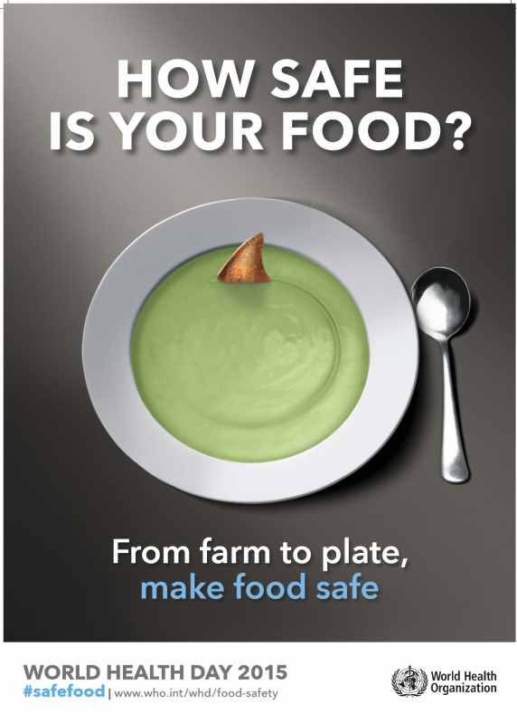
Learning objectives
Understand that there are both useful and harmful microbes in food, where they can be found, and risks and consequences of food poisoning
    To learn about foodborne illnesses occurring in the home and elsewhere and full consequences that can arise as a result
      To understand that the home could be a riskier cooking environment compared to eating at food establishments
      To develop more of a global perspective about food poisoning
      To teach food safety and food hygiene through multicultural differences
    To understand/identify the different aspects of food (nutrition, ecology, microbiology, allergy…)
Curriculum links
Test your knowledge
Do the post-test
X
Close
<
Previous Next
>
Close
Next

Slide 3
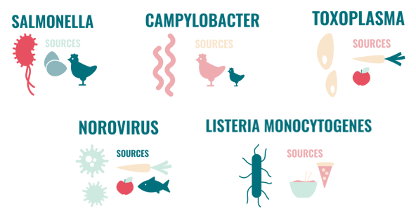

European and National
context
Curriculum links
Test your knowledge
More about the top five hazards : download session 2
Key figures
  Recent analyses from WHO (1) estimate that bacteria, parasites, toxins and allergens in food account for about 23 million cases of illness and 5000 deaths in Europe every year.
Nearly 40% of foodborne outbreaks occur in the home and food safety violations at the consumer stage are common, particularly due to poor hygiene and insufficient heating and cooling (2).
The top five foodborne hazards in Europe (1), accounting for about 70% of the health burden related to food borne illness are:
  Salmonella
  Campylobacter
  Toxoplasma
  Norovirus
  Listeria monocytogenes
Common to these hazards is that consumers themselves, through safe behaviour (food choice, storage and preparation), can partly or completely eliminate risk.
Do the post-test
X
Close
<
Previous Next
>
Close
Next
(1)WHO (2015) Estimates of the global burden of foodborne illness
(2) EFSA (2015) EFSA Journal 13:3991

Slide 4
Food in a global perspective*
Nutrition is the intake of food, considered in relation
to the body’s dietary needs. Good nutrition – an adequate, well balanced diet combined with regular physical activity – is a cornerstone of good health. Poor nutrition can lead to reduced immunity, increased susceptibility to disease, impaired physical and mental development, and reduced productivity. Overweight and obesity is due to an increased intake of energy-dense foods that are high in fat; and an increase in physical inactivity due to the increasingly sedentary nature of many forms of work, changing modes of transportation, and increasing urbanization.
X
The five stages involving critical handling of
food covered by the Safeconsume resources (food procurement, transportation, storage, preparation and serving) all involve socially shared activities carried out in everyday life of European consumers. Cultural influence is important and needs to be taken into account when teaching students.
X
Nutrition
Microbiology
Curriculum links
Test your knowledge
More information
Nutrition
Culture
Microbiology
Food involves a lot of useful and harmful bacteria.
The food we eat has often been produced with the help of micro-organisms : Useful microbes lesson e-Bug
It will be digested in our gut with the help of our microbiota.
Depending on how it’s handled it can bring us harmful micro-organisms.
Food allergy is an adverse reaction to food
involving an immunological mechanism, with an estimated prevalence of food allergies around 1-3% in adults and 4-6% in children. The foods, which cause the most severe reactions and most cases of food allergies are: cereals containing gluten, crustacean, eggs, fish, peanuts, soybeans, milk, and tree nuts. An allergic person should avoid the causes which is the reason to current recommendations of declaring these foods on food labels.
X
X
Allergy
Ecology
Chemical hazards have a lower health burden than micro-organisms
(with only Dioxin ranked among the top ten hazards) and can to little extent be managed at the consumer stage (except choice when shopping).
In Europe, the safety of food production is controlled in each country.
X
Do the post-test
* Not comprehensive
X
Close
Previous
<
Close
Next

Slide 5

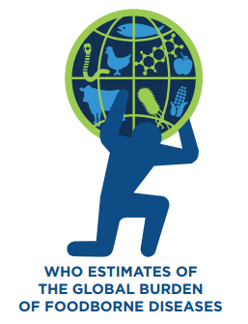

The burden of foodborne diseases in Europe
Source: THE BURDEN OF FOODBORNE DISEASES IN THE WHO EUROPEAN REGION
X
Close and go back to session 1
Previous Next
>
Close
Next

Slide 6

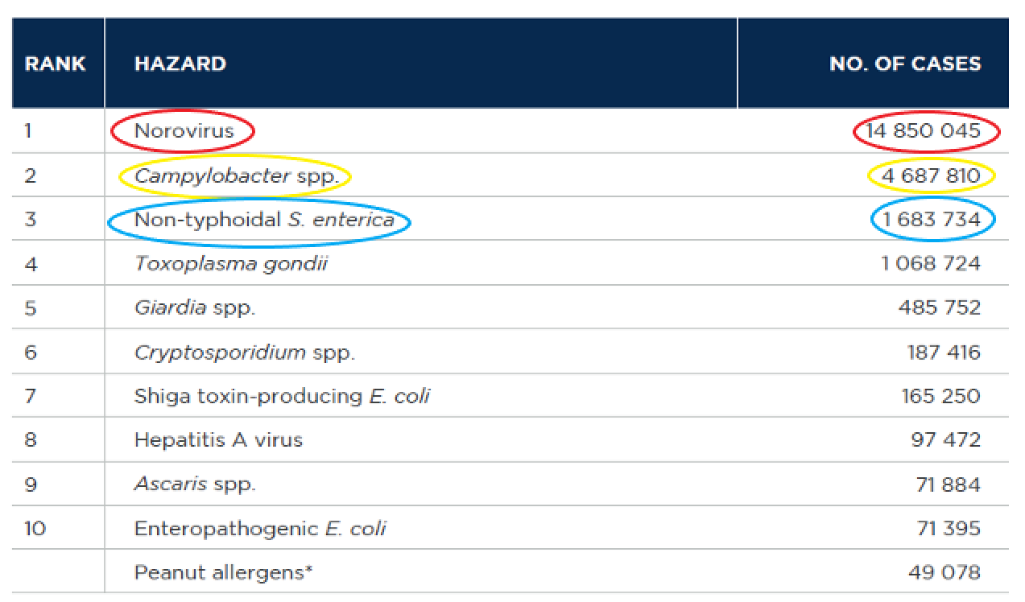


Leading causes of foodborne illnesses
Leading causes of foodborne illnesses in the
WHO European Region (2010)
Leading causes
DALYs
Deaths
1
almost 15 million cases
2
nearly 5 million cases
3
1,7 million cases
X
Close and go back to session 1
<
Previous Next
>
Close
Next

Slide 7

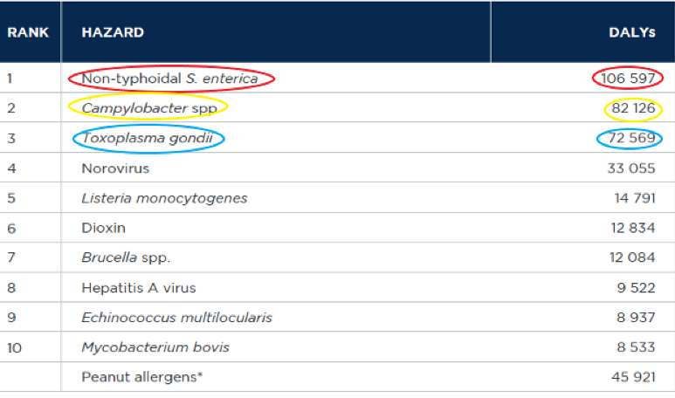

Leading causes of DALYs due to foodborne illnesses
Leading causes of disability-adjusted life years (DALYs) due to foodborne diseases in European Region (2010)
Leading causes
DALYs
Deaths
1
107 000 DALYs
*
2
82 000 DALYs
*DALY (Disability Adjusted Life Years) is the summary measure used to give an indication of overall burden of disease. It reflects the sum of years of life lost due to premature mortality and years of life lost due to years lived in poor health. One DALY represents the loss of the equivalent of one year of full health.
Note: a disease can have a high DALY either due to a high case-fatality rate (example: Listeria monocytogenes) or due to a high incidence (example: Norovirus).
3
73 000 DALYs
For Salmonella it was the mortality contribution that was the most important in the Daly’s calculation while for Campylobacter and Toxoplasma it was the morbidity and disability.
X
Close and go back to session 1
<
Previous Next
>
Close
Next

Slide 8
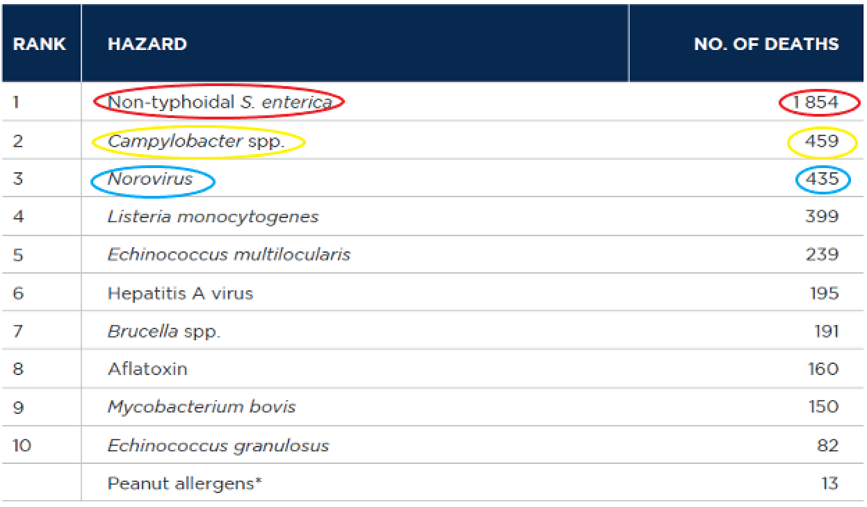

Leading causes of death due to foodborne illnesses
Leading causes of death due to foodborne diseases in European Region (2010)
Leading causes
DALYs
Deaths
1
1 854 deaths
2
459 deaths
3
435 deaths
For Listeria the incidence is relatively low, but the hospitalization and fatality rates are high:
1 781 cases of illness, 399 deaths and almost 15 000 DALYs.
X
Close and go back to session 1
Previous
<
Close
Next

Slide 9
Food in a global perspective
Resources to learn more
X
Close and go back to session 1
Previous Next
>
Close
Next

Slide 10
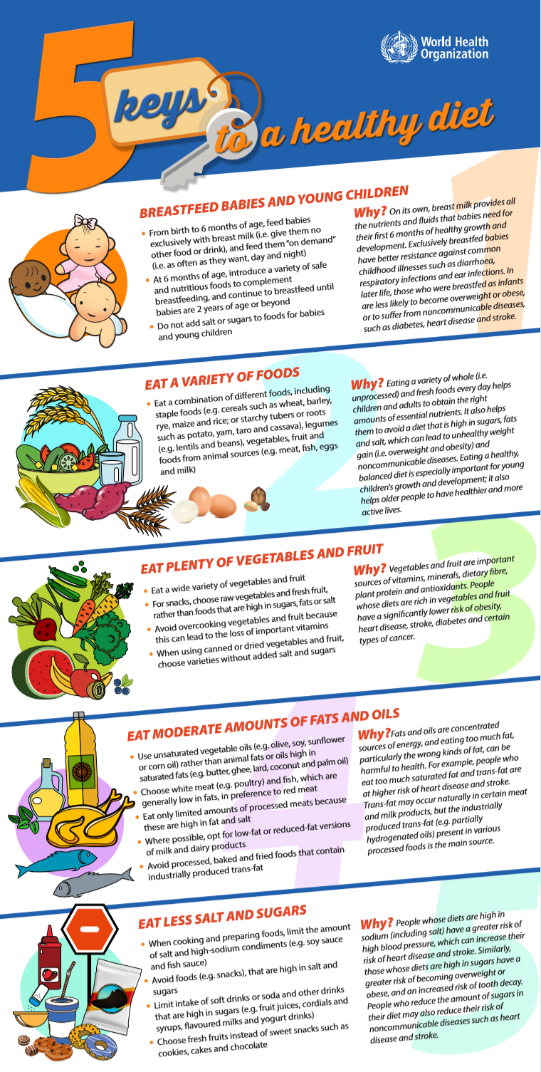
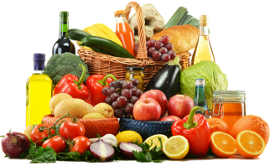
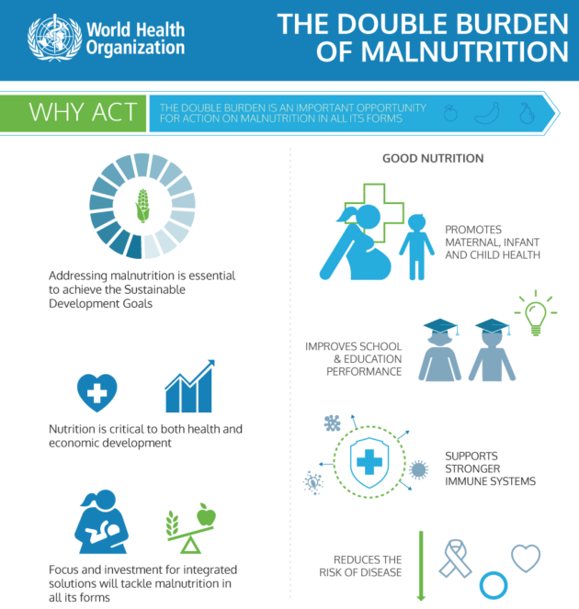

Nutrition
Nutrition is the intake of food, considered in relation to the body’s dietary needs.
Good nutrition – an adequate, well balanced diet combined with regular physical activity – is a cornerstone of good health.
Poor nutrition can lead to reduced immunity, increased susceptibility to disease, impaired physical and mental development, and reduced productivity.
Nutrition
Microbiology
Ecology
Allergy
Culture
X
Close and go back to session 1
<
Previous Next
>
Close
Next

Slide 11
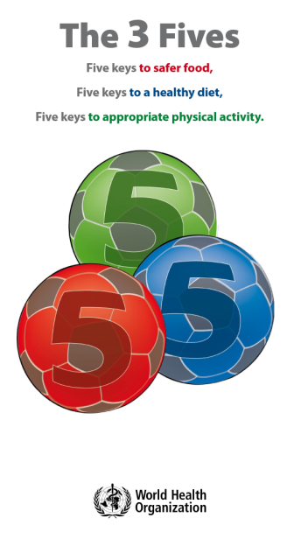
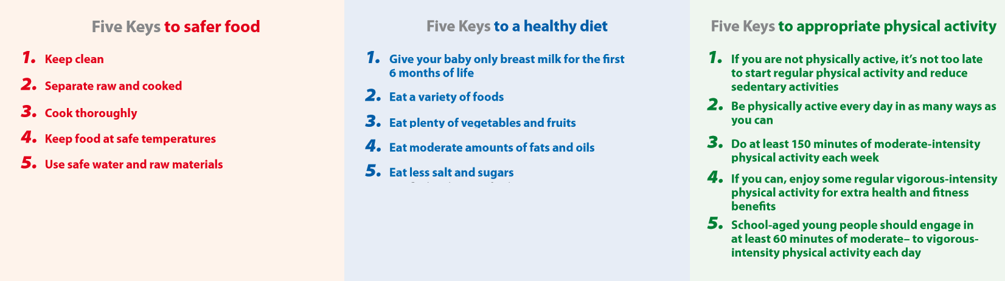
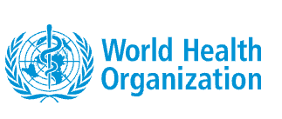
Nutrition
Nutrition
Microbiology
Ecology
Allergy
Culture
For more informations:
Poster the 3 Fives
Health topics: Nutrition
X
Close and go back to session 1
<
Previous Next
>
Close
Next

Slide 12

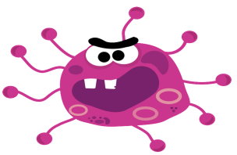
Microbiology
The contamination of food by microbiological agents is a worldwide public health concern. Most countries have documented significant increases over the past few decades in the incidence of diseases caused by microorganisms in food, including pathogens such as Salmonella, and enterohaemorrhagic Escherichia coli, and parasites such as cryptosporidium and trematodes.
WHO : five keys to safer food video
Nutrition
Microbiology
Ecology
Allergy
Culture
For more informations:
Microbiological risks
X
Close and go back to session 1
<
Previous Next
>
Close
Next

Slide 13
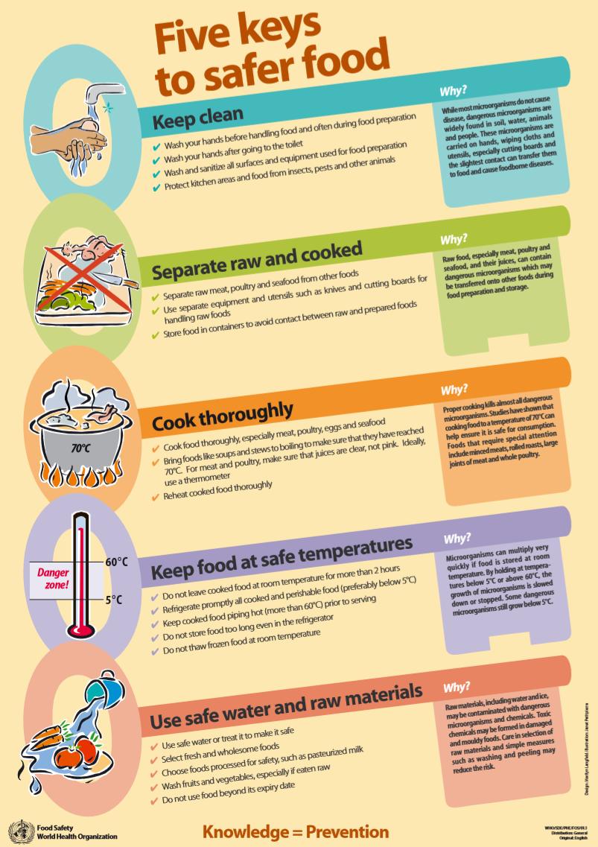
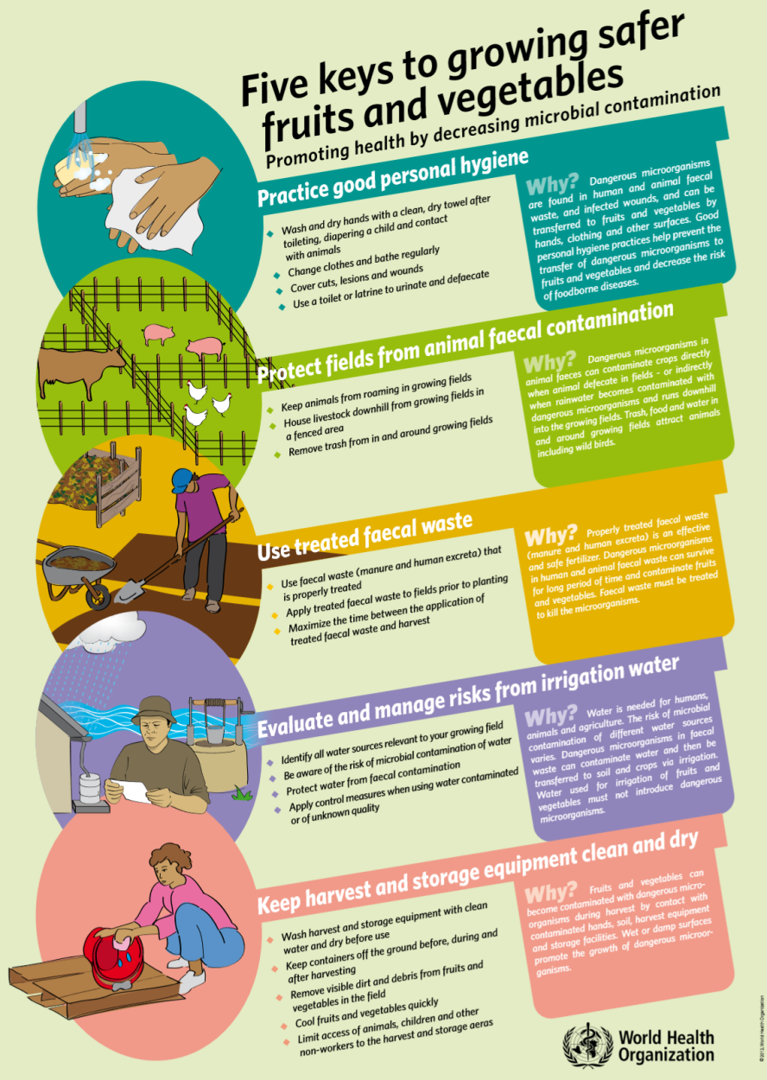
Microbiology
Nutrition
Microbiology
Ecology
Allergy
Culture
X
Close and go back to session 1
<
Previous Next
>
Close
Next

Slide 14
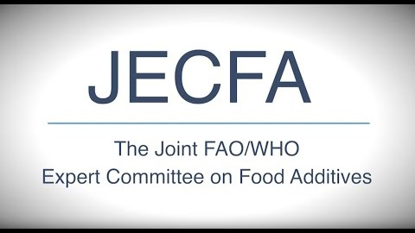
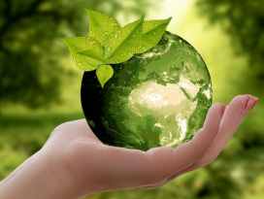
Ecology
Food additives:
Food additives are substances added to food to maintain or improve its safety, freshness, taste, texture, or appearance.
They need to be checked for potential harmful effects on human health before they can be used.
The Joint FAO/WHO Expert Committee on Food Additives (JECFA), is the international body responsible for evaluating the safety of food additives.
Only food additives that have been evaluated and deemed safe by JECFA, on the basis of which maximum use levels have been established by the Codex Alimentarius Commission, can be used in foods that are traded internationally.
Nutrition
Microbiology
Ecology
Allergy
Culture
For more informations:
Food additives
X
Close and go back to session 1
<
Previous Next
>
Close
Next

Slide 15
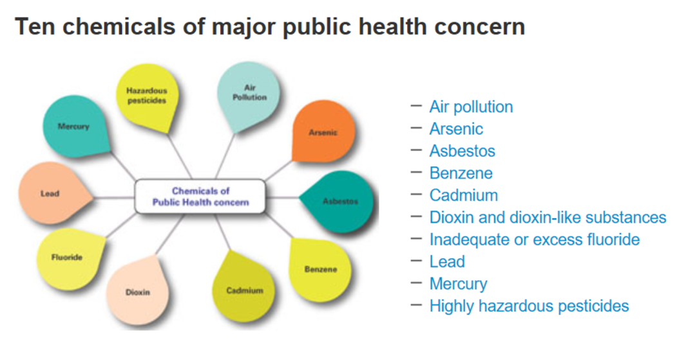
Ecology
Pesticides:
Pesticides are used to protect crops against insects, weeds, fungi and other pests.
They are potentially toxic to humans and can have both acute and chronic health effects, depending on the quantity and ways in which a person is exposed.
Pesticides play a significant role in food production. They protect or increase yields and the number of times per year a crop can be grown on the same land. This is particularly important in countries that face food shortages.
To protect food consumers from adverse effects of pesticides, WHO reviews evidence and develops internationally-accepted maximum residue limits.
Nutrition
Microbiology
Ecology
Allergy
Culture
For more informations:
WHO : ten chemicals of major public health concern
Pesticide residues in food
X
Close and go back to session 1
<
Previous Next
>
Close
Next

Slide 16



Ecology
Endocrine disrupters:
Endocrine disruptor is an exogenous substance or mixture that can have harmful effects on the body's endocrine (hormone) system. Hormones act in very small amounts and at precise moments in time to regulate several body's functions. Endocrine disruptors interfere with natural hormone systems, and the health effects can be felt long after the exposure has stopped. Exposure to endocrine disruptors in the womb can have life-long effects.
There is growing concern in the EU and worldwide about negative impacts possibly caused by endocrine disruptors. In REACH, endocrine disrupting chemicals are considered of similar regulatory concern as substances of very high concern.
In June 2018, EFSA and the European Chemicals Agency (ECHA) published their guidance on how to identify substances with endocrine disrupting properties in pesticides and biocides.
The guidance was drafted by scientific staff from EFSA, ECHA and the European Commission’s Joint Research Centre.
For more informations:
Nutrition
Microbiology
Ecology
Allergy
Culture
Endocrine active substances
Video: The Endocrine System and food safety
Endocrine Disruptors
Global assessment of the state-of-the-science of endocrine disruptors
X
Close and go back to session 1
<
Previous Next
>
Close
Next

Slide 17
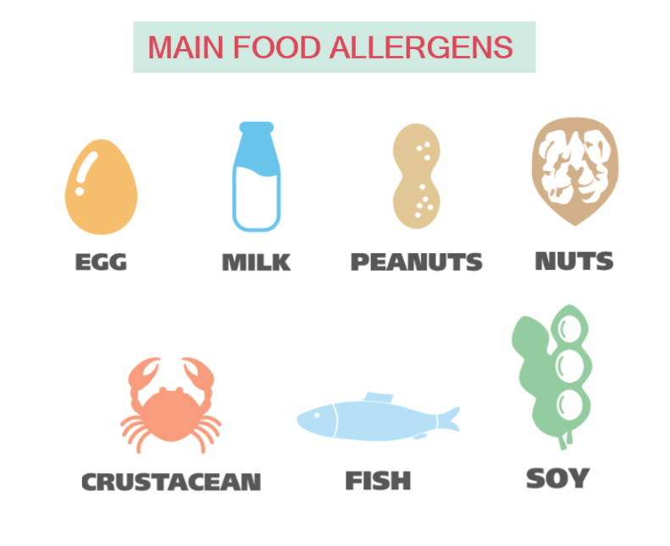




Allergy
More than 17 million people in Europe suffer from food allergies (3,5 million < 25 years). Food allergy is the leading cause of anaphylaxis in children aged 0-14 years (EAACI : European Academy of Allergy and Clinical Immunology)
A food allergy is when the body's immune system reacts unusually to specific foods. Although allergic reactions are often mild, they can be very serious.
Symptoms : can affect different areas of the body at the same time :
  an itchy sensation inside the mouth, throat or ears
  a raised itchy red rash
  swelling of the face, around the eyes, lips, tongue and roof of the mouth
  vomiting
For reasons that are unclear, rates of food allergies have risen sharply
in the last 20 years.
Treatment : identify the food that causes the allergy and avoid it.
Nutrition
Microbiology
Ecology
Allergy
Culture
For more informations:
Overview: food allergy
Literature searches and reviews related to the prevalence of food allergy in Europe
Labelling and allergens
Food allergy and intolerance
X
Close and go back to session 1
<
Previous Next
>
Close
Next

Slide 18
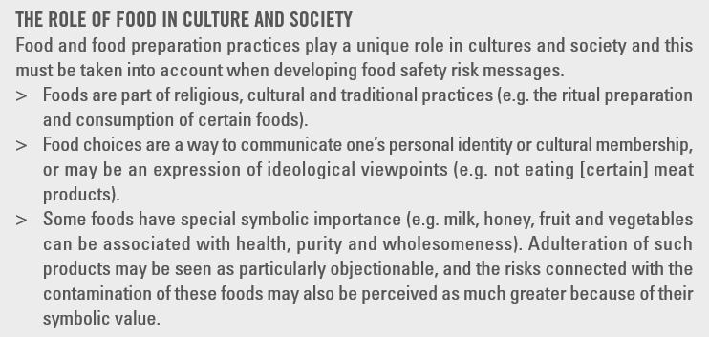
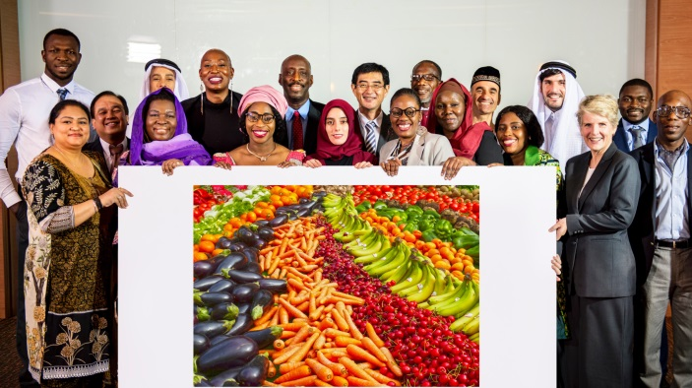
Culture
Food and food preparation practices play a unique role in cultures and society → adapat food safety messages
Suggesting problems with these food preparation or consumption practices (what people do) may be perceived as criticism of their identities (who people are) As a result, traditions and practices are difficult to change simply by providing food safety risk information
Source : risk communication applied to food safety handbook
Nutrition
Microbiology
Ecology
Allergy
Culture
X
Close and go back to session 1
Previous
<
Close
Next

Slide 19

Curriculum Links
KS2/KS3
RSHE; Health and prevention, Healthy eating
Science; Living things and their habitats
KS4:
Food preparation and nutrition GCSE; Cooking and food preparation - the scientific principles underlying the preparation and cooking of food.
Close and go back to session 1
X
Close
Next

